Slide 1

Department of Computer Science and Engineering
Comparative Genomic Data Science for Cancer and Liver Disease Classification
Proposed By
MdTahsin Islam Chowdhury
230240012
Supervised by
Md. Asaduzzaman
Lecturer

Slide 2

Outlines
Introduction
Problem Statements
Research Objectives
Literature Review
Methodology
Tools and Technologies
Outcomes
Conclusion
References

Slide 3
Introduction
Genomic data science analyzes biological information using computational methods and advanced machine learning techniques.
Cancer and liver disease cause significant global mortality, requiring accurate early diagnostic approaches urgently.
Gene expression analysis identifies molecular patterns associated with disease development, progression, and treatment responses.
Public genomic datasets provide reliable biological information for comparative disease classification research studies.
Machine learning algorithms improve classification accuracy using informative genomic features from gene expression.
Comparative genomic analysis supports biomarker discovery, precision medicine, and effective disease diagnosis advancements.

Slide 4
Problem Statements
Comparative genomic analyses between cancer and liver disease remain limited using public genomic datasets.
Existing studies primarily investigate individual diseases instead of comprehensive cross-disease genomic comparisons effectively.
Shared biomarkers and disease-specific genetic patterns remain insufficiently explored across multiple genomic datasets.
High-dimensional genomic data creates challenges for accurate disease classification using conventional analytical methods.
Lack of standardized comparative frameworks reduces reliability, reproducibility, and clinical applicability of genomic studies.
Effective machine learning approaches are needed for improved genomic disease classification and biomarker discovery.

Slide 5
Research Objectives
Collect and preprocess publicly available genomic datasets from reliable NCBI GEO repositories efficiently.
Identify differentially expressed genes associated with cancer and liver disease through comparative genomic analysis.
Compare shared and disease-specific gene expression patterns across both selected genomic datasets accurately.
Investigate disease-associated genetic variations using standardized bioinformatics techniques and computational analysis methods effectively.
Perform Gene Ontology and pathway enrichment analyses identifying significant biological processes and pathways.
Discover potential biomarkers improving disease diagnosis, classification, precision medicine, and targeted therapeutic development.

Slide 6
Literature Review
Author & Year | Research Focus | Key Findings | Research Gap
Oh et al. (2020) | Liver Biomarkers | Identified genomic liver biomarkers | Cancer comparison missing
Ramachandran et al. (2020) | Liver Genomics | Explained liver cellular diversity | Comparative classification absent
Rosati et al. (2024) | DEG Pipelines | Reviewed biomarker identification tools | Cross-disease analysis limited
Shibata & Aburatani (2014) | Liver Cancer Genomics | Improved understanding of mutations | Single disease focus
Yu et al. (2024) | Batch Effect Correction | Increased omics data reliability | Comparative genomic classification absent

Slide 7
Methodology
Collect cancer and liver disease gene expression datasets from NCBI GEO database repositories.
Remove duplicate samples and handle missing values ensuring reliable genomic dataset quality consistently.
Normalize gene expression data and select informative features improving classification performance significantly overall.
Split processed datasets into seventy percent training and thirty percent testing subsets systematically.
Train Decision Tree, Random Forest, Support Vector Machine, and KNN classification models effectively.
Evaluate model performance using accuracy, precision, recall, F1-score, and confusion matrix metrics.
Compare classification results identifying optimal machine learning model for genomic disease prediction accuracy.

Slide 8
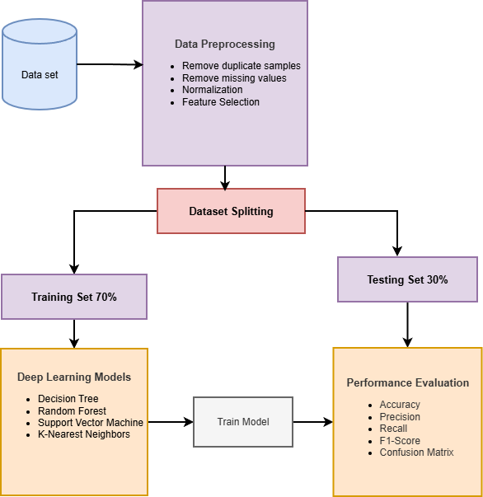
Methodology

Slide 9
Tools and Technologies
Python: Data preprocessing and machine learning implementation.
Jupyter Notebook: Coding, testing, and experiment execution.
NCBI GEO: Public genomic gene expression datasets.
NumPy: Numerical computation and array processing.
Pandas: Data cleaning and preprocessing.
Scikit-learn: Machine learning model development.
Matplotlib & Seaborn: Data visualization and performance analysis.

Slide 10
Outcomes
Develop an accurate machine learning framework for cancer and liver disease classification successfully.
Identify significant gene expression patterns associated with cancer and liver disease progression accurately.
Discover potential biomarkers supporting early diagnosis and personalized treatment strategies for patients effectively.
Compare machine learning algorithms identifying highest performing model for genomic disease classification accuracy.
Improve understanding of shared and disease-specific molecular mechanisms through comparative genomic analysis studies.
Support future precision medicine research using reliable genomic datasets and computational analytical approaches.
Provide reproducible comparative genomic analysis framework benefiting biomedical researchers and healthcare professionals globally.

Slide 11
Conclusion
Comparative genomic analysis enhances understanding of cancer and liver disease molecular mechanisms effectively.
Machine learning models improve accurate classification using publicly available genomic gene expression datasets.
Data preprocessing ensures reliable genomic information for effective disease prediction and comparative analysis.
Comparative evaluation identifies optimal machine learning algorithms for accurate genomic disease classification performance.
Identified genomic patterns support biomarker discovery and future personalized precision medicine research initiatives.
Proposed framework provides reliable, scalable approach for comparative genomic disease classification and analysis.
Research contributes valuable computational insights supporting future biomedical research and clinical decision making.

Slide 12
References
Oh, S., Jo, Y., Jung, S., Yoon, S., and Yoo, K. H. (2020). From genome sequencing to the discovery of potential biomarkers in liver disease. BMB Reports, 53(6), 299–310.
Ramachandran, P. et al. (2020). Single-cell genomics and spatial transcriptomics in liver physiology and disease biology. Journal of Hepatology, 73(5), 1219–1230.
Rosati, D., Palmieri, M., Brunelli, G., Morrione, A., Iannelli, F., Frullanti, E., and Giordano, A. (2024). Differential gene expression analysis pipelines and bioinformatic tools for the identification of specific biomarkers: A review. Computational and Structural Biotechnology Journal, 23, 1154–1168.
Shibata, T., and Aburatani, H. (2014). Exploration of liver cancer genomes. Nature Reviews Gastroenterology & Hepatology, 11(6), 340–349.
Yu, Y. et al. (2024). Assessing and mitigating batch effects in large-scale omics studies. Genome Biology, 25.

